Slide 1

Lesson 6: Communication over networks
Digital environments
Notes:
Version 1, June 2024

Slide 2

Network hardware – study question
Starter activity
An independent hotel has a small wired local area network that is used to connect computers in the reception area and back office.
Evaluate the use of a switch to connect computers together at the hotel.
A switch connects multiple wired devices together. When the switch receives incoming data, it transfers it to the specific device to which it is addressed. As a switch only sends data to the device to which it is addressed, network traffic is reduced and data privacy is increased, which may be important if the hotel is processing customer information. A switch would be suitable for the hotel as it would allow the computers to be connected together and would allow for reliable and secure communication.
Notes:
Photo by Kateryna Naidenko from Pexels: https://www.pexels.com/photo/high-angle-view-on-people-at-the-reception-desk-in-a-hotel-7512139/

Slide 3
Lesson 6: Communication over networks
Objectives
In this lesson you will:
Describe how applications communicate over a network
Compare the layers of the OSI and TCP/IP models
Distinguish between network layers and protocols that operate on each layer
General competencies:
E1 - convey technical information
E2 - present information and ideas
E4 - summarise information
E5 - synthesise information
E6 - take part in discussions
D2 - design digital media
D3 - communicate and collaborate

Slide 4
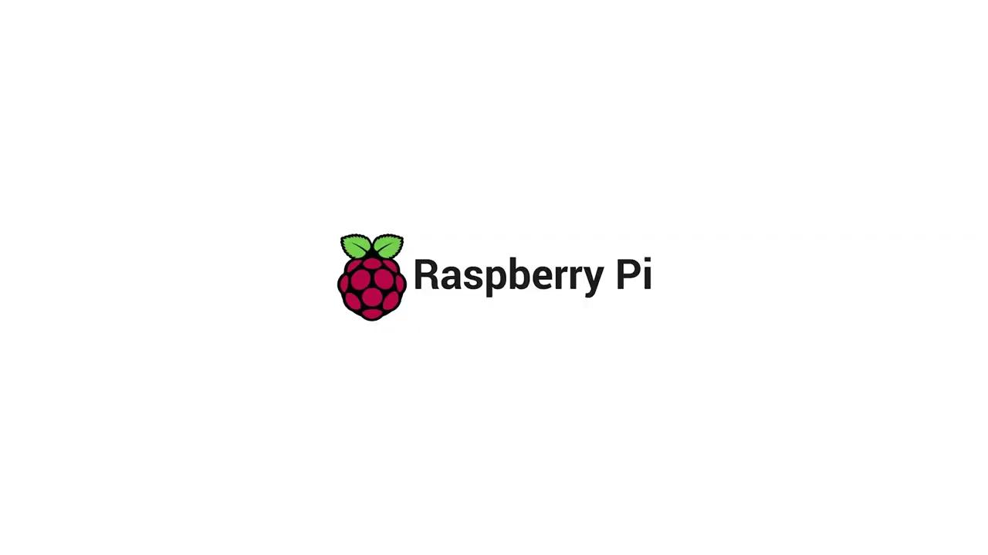

Starter activity
How many devices do you connect to the internet?
Notes:
A0 Communication film: https://vimeo.com/883954052

Slide 5
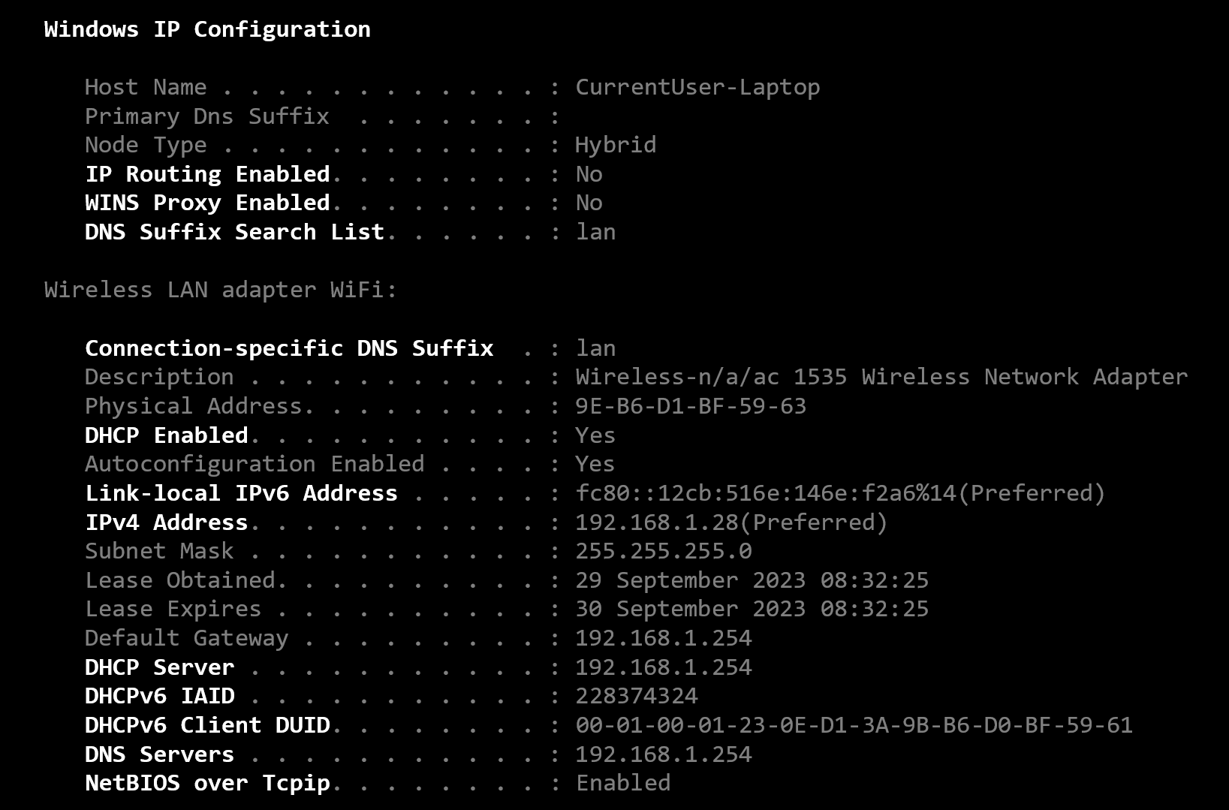
Protocols
Activity 1
Last lesson, you learnt how protocols are used to define rules for communication.
You also learnt about some common protocols used in networking such as DNS, HTTP, and FTP.
Applications at the communication endpoints will use the same protocol.

Slide 6

Standards
Activity 1
Network protocols are organised as a sequence of layers through which the data is passed.
The sequence of layers can be visualised as sitting on top of each other to form a stack. This is called a protocol stack.
Different protocols operate at each layer.
Notes:
Photo by Mikhail Nilov from Pexels: https://www.pexels.com/photo/people-using-computers-at-work-7988079/

Slide 7
The OSI seven-layer model
Activity 1
The Open Systems Interconnection (OSI) seven-layer model was developed in the 1970s by the International Organization for Standardization (ISO) in a response to the emergence of diverse networking methods.
Application
Presentation
Session
Transport
Network
Data link
Physical

Slide 8
The TCP/IP four-layer model
Activity 1
OSI
TCP/IP
As the internet developed, the internet community defined new standards and simplified the seven-layer model by merging some layers.
Transmission control protocol/internet protocol (TCP/IP) are the main protocols that are used for communication between computers on the internet.
Application
Application
Presentation
Session
Transport
Transport
Network
Internet
Data link
Link
Physical

Slide 9

Encapsulation
Activity 1
When sending information, each of the layers in the model accepts information from the layer above (or from a program, in the case of the application layer). It will then add another wrapper with its additional information before passing this down to the next layer. This process is called encapsulation.
At the receiving end, the wrappers are removed by each layer, similar to the ‘pass the parcel’ game. The process of removing header (and trailer if present) as it moves up the stack is called decapsulation.

Slide 10
Step-by-step HTTP request
Activity 1
client
server
Consider the following example:
You want to access the Raspberry Pi Foundation website, so you type “raspberrypi.org” into the address bar of your browser.
Let’s follow the journey of this request as it travels from your web browser and across the internet to the web server application at the Raspberry Pi Foundation.
Application layer
Application layer
Transport layer
Transport layer
Internet layer
Internet layer
Link layer
Link layer

Slide 11
Step-by-step HTTP request
Activity 1
client
server
Each different type of application uses one or more different protocols. These protocols are implemented in software as subprograms, procedures, or subroutines.
Your web browser (the client) will use the Hypertext Transfer Protocol (HTTP) to communicate with the application layer on the Raspberry Pi Foundation’s web server.
The application layer contains a whole suite of different protocols designed to encode/decode messages into a form that is understood by the sender and the recipient devices.
Application layer
Application layer
Transport layer
Transport layer
Internet layer
Internet layer
Link layer
Link layer

Slide 12
Step-by-step HTTP request
Activity 1
client
server
At the transport layer, the two main protocols that are used are Transmission Control Protocol (TCP) and User Datagram Protocol (UDP).
Web browsing requires complete (reliable) data, so uses TCP. You will learn more about reliable and unreliable transmission later.
The data from the application layer, i.e. your HTTP request, is broken down and formatted into one or more segments.
Each segment is given a header that contains a sequence number so that TCP can keep track of the segments. A checksum is calculated and added to the header to help with error detection.
Application layer
Application layer
Transport layer
Transport layer
Internet layer
Internet layer
Link layer
Link layer

Slide 13
Step-by-step HTTP request
Activity 1
client
server
The internet layer (sometimes called the network layer) receives the TCP segments from the transport layer. It takes these segments and encapsulates them into IP packets.
Each IP packet is given a header containing data to assist with delivery. The header will contain the IP address of the packet source and the IP address of its destination. This is so that the packets can be routed to the correct destination, i.e. the Raspberry Pi Foundation web server.
Application layer
Application layer
Transport layer
Transport layer
Internet layer
Internet layer
Link layer
Link layer

Slide 14
Step-by-step HTTP request
Activity 1
client
server
The link layer (sometimes called the data link layer) enables the physical transfer of the packets.
Your device may have many technologies to connect to a network such as Ethernet, Wi-Fi, or Bluetooth. Once the link has been chosen, the appropriate link layer protocol is selected.
For example, if your device is connected to a network using Ethernet, the IP packets from the internet layer are further encapsulated in Ethernet frames which are designed to be transmitted across a local network.
Application layer
Application layer
Transport layer
Transport layer
Internet layer
Internet layer
Link layer
Link layer

Slide 15
Step-by-step HTTP request
Activity 1
client
server
An IP packet can be encapsulated and decapsulated several times as it traverses the internet.
Each time a packet encounters a new link, it will be encapsulated in a different frame suitable for that link technology.
Each frame will be given the address of the next node. This address is the media access control address or MAC address of that node.
Application layer
Application layer
Transport layer
Transport layer
Internet layer
Internet layer
Link layer
Link layer

Slide 16
Step-by-step HTTP request
Activity 1
client
server
Eventually, the packets containing the HTTP request will reach their final destination, i.e. the Raspberry Pi Foundation web server.
Each frame, as it arrives, will be decapsulated and the IP packets will be passed from the link layer to the internet layer.
Application layer
Application layer
Transport layer
Transport layer
Internet layer
Internet layer
Link layer
Link layer

Slide 17
Step-by-step HTTP request
Activity 1
client
server
At the internet layer on the web server, each IP packet will be decapsulated and the TCP segment will be passed to the transport layer.
Application layer
Application layer
Transport layer
Transport layer
Internet layer
Internet layer
Link layer
Link layer

Slide 18
Step-by-step HTTP request
Activity 1
client
server
At the transport layer on the web server, the segments will be checked and put into sequence (if they arrived out of order).
Each segment is acknowledged and any missing segments will be retransmitted.
The complete HTTP request is passed to the application layer.
Application layer
Application layer
Transport layer
Transport layer
Internet layer
Internet layer
Link layer
Link layer

Slide 19
Step-by-step HTTP request
Activity 1
client
server
At the application layer on the web server, the request for the webpage is received.
The web server will respond to the request by getting all of the data needed for the webpage.
This data is then formatted as an HTTP response and passed down to the transport layer to start its journey back to the client that requested the page.
Application layer
Application layer
Transport layer
Transport layer
Internet layer
Internet layer
Link layer
Link layer

Slide 20
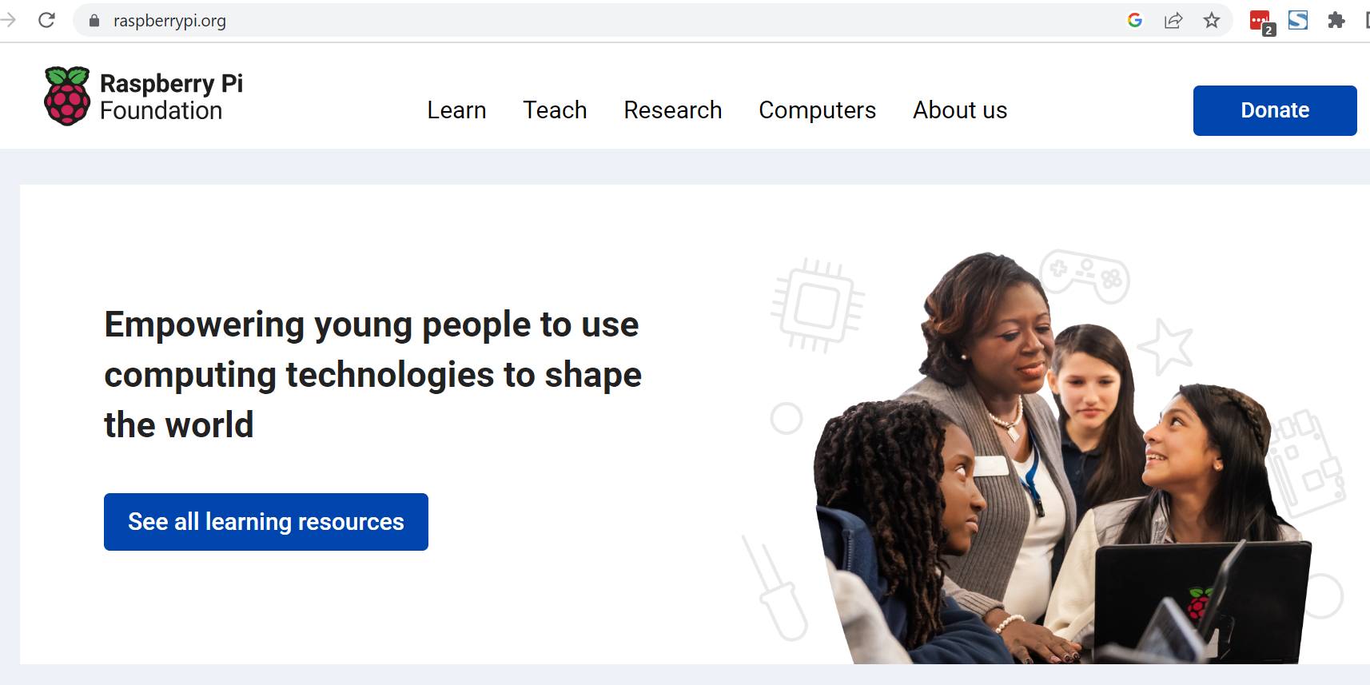
Step-by-step HTTP request
Activity 1
client
server
Eventually the data will be received back at the application layer on the client and displayed to the user.
Application layer
Application layer
Application layer
Application layer
Transport layer
Transport layer
Transport layer
Transport layer
Internet layer
Internet layer
Internet layer
Internet layer
Link layer
Link layer
Link layer
Link layer

Slide 21
Networking models
Activity 1
Networking models
OSI and TCP/IP
The OSI model is a reference model that network engineers use to allow them to separate the processes that take place during network transmission. It also illustrates how the layers communicate with one another. The TCP/IP model is an implementation of the OSI model.
The OSI model has seven layers and the TCP/IP model has four layers. You can see how they relate to each other by looking at the diagram below:
Open and complete ‘A1 Activity sheet – Networking models’ to test your understanding of the OSI and TCP/IP network models.
OSI
TCP/IP
Application
Application
Presentation
Session
Transport
Transport
Network
Internet
Data link
Link
Physical

Slide 22
Networking models – solutions
Activity 1
Description | Layer
Breaks the data into segments and adds a header that contains the source and destination ports.
Deals with the parts of an application that connect to a network. It is the closest layer to the end user of the network, and talks directly to the application.
Deals with how the bits of data are transmitted through a network. This could be through light pulses, electrical signals, or radio waves.
Deals with ensuring that data is transmitted, error-free, from one node to another on a network.
Provides the necessary means for establishing a connection, organising, and synchronising data exchange.
Deals with outputting the data in the correct format. It might also decrypt and encrypt data where required.
Creates an IP packet that includes the source and destination IP addresses.
Transport
Application
Physical
Data link
Session
Presentation
Network
22

Slide 23
Networking models – Study question
Activity 1
Explain what happens at the link layer and transport layer of the TCP/IP model.
The link layer deals with the physical transfer of packets. Depending on how the device is connected to a network (Ethernet, Wi-Fi, etc.), the appropriate link layer protocol will be selected.
The transport layer uses two main protocols — TCP and UDP. The data from the application layer is broken down into segments. Each segment is given a header that contains a sequence number so that the protocol can keep track of the packets.
23

Slide 24

Industry spotlight
Activity 3
Laura is a Learning Manager at the Raspberry Pi Foundation, a UK-based educational charity with the mission to enable young people to realise their full potential through the power of computing and digital technologies.
She develops content and learning resources for educators and students. She also goes into schools to run Code Clubs.
Laura works remotely and also connects her devices to networks when working out and about in schools.
What types of network do you think Laura uses? What protocols would be used for communication over these networks?

Slide 25
Protocols and the layers in which they operate
Retrieval activity
Application
IP
HTTP
FTTP
DHCP
Wi-Fi
HTTP
Transport
TCP
TCP
UDP
DHCP
Internet
FTTP
IP
ARP
Ethernet
ARP
Link
UDP
Wi-Fi
Ethernet

Slide 26

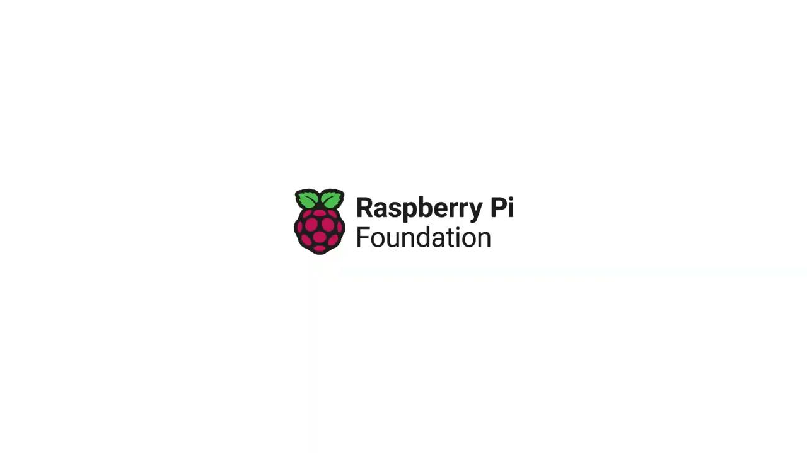
Activity 2
How can a protocol be unreliable?
Notes:
A2 Reliable protocols film: https://vimeo.com/883953942

Slide 27
Comparing models
Activity 2
OSI
TCP/IP
In pairs, discuss the seven-layer OSI model and the four-layer TCP/IP model.
Describe the layers of each model and the protocols that operate at each layer.
Discuss the similarities and differences between the two models.
Application
Application
Presentation
Session
Transport
Transport
Network
Internet
Data link
Link
Physical

Slide 28
Comparing models – possible solutions
Activity 2
OSI
TCP/IP
Both the seven-layer OSI model and the four-layer TCP/IP model are used to describe how applications communicate over a network. While the functions of each layer are similar, the number of layers and the related protocols differ. The TCP/IP model combines the presentation, session, and application layers into a single layer — the application layer.
1.
Application
Application
Presentation
Session
Transport
Transport
Network
Internet
Data link
Link
Physical

Slide 29
Name the missing layers
Retrieval activity
Question
Name the layers that are missing from the OSI model.
OSI
Application
?
Presentation
?
Session
Transport
?
Network
Data link
?
Physical

Slide 30

Apply it – activity
Apply it
Trainer Trader is a supplier of limited edition designer trainers that was started by Sam whilst they were studying at University.
Sam currently sells trainers via third party retail sites. The business is doing really well and Sam wants to develop their own online purchasing site. This will enable them to manage orders more efficiently and not have to pay fees each time they sell a pair of trainers.
In pairs, research what protocols would be most suitable for the online store. You should be prepared to share your findings with the rest of the group.
Include a rationale for your choices and the benefits to the organisation of each.
Explorer task: consider a larger web based business, would the protocols they use differ from Trainer Trader?
Notes:
Photo by Arthur Ogleznev from Pexels: https://www.pexels.com/photo/person-wearing-white-and-blue-air-jordan-1-s-1102777/

Slide 31
Apply it – sample answer
Apply it
A protocol is a set of rules that networked devices must follow in order to communicate with each other.
HTTP (Hypertext Transfer Protocol) is a protocol that is used to request and transfer webpages across the internet. The web browser on your device is called the 'client'. It requests webpages and linked resources from the web server. HTTPS — a secure version of this protocol — adds in extra protection for the data that is transmitted. HTTPS encrypts the data exchanged between client and server.
Trainer Trader will need to use HTTPS for the secure payment system on their website. Customers will want to know that their payment and personal information will be kept secure during the payment process.
A digital certificate (sometimes called an SSL certificate) is installed on a web server and authenticates the identity of the website to ensure that the user is not on a bogus website. The certificate also encrypts the data that is being transmitted so it cannot be intercepted.

Slide 32
Next lesson
Summary
In this lesson, you…
Described how applications communicate over a network
Compared the layers of the OSI and TCP/IP models
Distinguished between network layers and protocols that operate on each layer
Next lesson, you will…
Examine the key features of virtual environments:
  Increased security
  Sharing
  Aggregation
  Emulation
  Isolation
  Portability
Analyse the benefits and drawbacks of the use of virtual environments in a range of contexts

