Slide 1
Science
Route: Health & Science
Topic: Good scientific and clinical practice
Lesson 5: Ordering and storing stock correctly
Notes:
Image © Shutterstock/Gorodenkoff

Slide 2
In this lesson, we will:
Introduction
Discuss reasons why it is important to order and manage stock effectively.
Explain some potential impacts of not storing materials and chemicals properly.
Skills:
CS3.2 health and safety requirements (for example, if storing and handling hazardous substances)
CS5.1 Solve a problem within a science context
CS6.1 Provide results and recommendations (written and verbal) to customers/clients
General competencies:
English:
GEC2 Present information and ideas
GEC4 Summarise information/ideas
GEC6 Take part in/lead discussions
Maths:
GMC2 Estimating, calculating and error spotting
GMC8 Communicating using mathematics
GMC10 Optimising work processes
Digital:
GDC3 Communicate and collaborate
GDC4 Process and analyse numerical data
Lesson 5: Ordering and storing stock correctly

Slide 3
Introduction
Introduction
Why is it important to order and manage stock effectively?
List as many reasons as you can.
Lesson 5: Ordering and storing stock correctly
Notes:
Image © Shutterstock/Gorodenkoff

Slide 4
Managing stock
Activity 1
Managing stock is important to:
ensure a sufficient supply of required consumables and materials
ensure that materials are used before their expiry date
reduce the costs of holding excess stock
minimise wastage
improve efficiency
improve productivity
ensure safety of stock, for example to check bottles for damage or broken seals, or to prevent a product degrading over time.
Lesson 5: Ordering and storing stock correctly

Slide 5
Managing stock
Activity 1
Complete the maths activity on Worksheet 1, where you are asked to perform a series of calculations to identify some of the challenges around managing chemical stock levels.
Mark your answers using Worksheet 2.
Resources needed
L5 Activity 1 Worksheet 1
L5 Activity 1 Worksheet 2
Lesson 5: Ordering and storing stock correctly

Slide 6
Chemical storage
Activity 2
You will now complete a short investigation into the effects of light and time on a particular chemical, hydrogen peroxide.
Hydrogen peroxide decomposes naturally according to the reaction:
2H₂O₂ → O₂ + 2H₂O
The presence of a catalyst (catalase) speeds up this decomposition reaction.
Follow the instructions on the worksheet to complete the investigation.
Resources needed
L5 Activity 2 Worksheet
Practical equipment
Lesson 5: Ordering and storing stock correctly

Slide 7
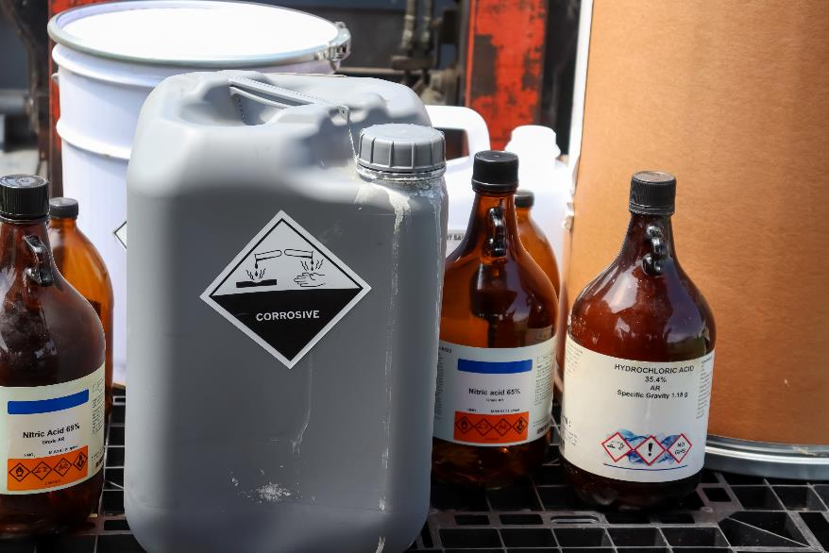
Chemical storage
Activity 2
What factors may cause chemicals to degrade?
Light
Time
Temperature
Exposure to oxygen
Exposure to water
Exposure to other substances
Lesson 5: Ordering and storing stock correctly
Notes:
Image © Shutterstock/chemical industry

Slide 8
Chemical storage
Activity 2
Incorrect chemical storage can cause:
a health and safety risk to employees - for example:
toxic gases may be released through chemical degradation
risk of spillage
risk of injury from being stored at inappropriate heights
financial loss
difficulties in locating stock which has been stored for extended periods of time
unintended reaction with reagents may not lead to the intended product/harmful gases could be released
rates of reactions may be slower than normal or not economically viable.
Lesson 5: Ordering and storing stock correctly

Slide 9
Storing products, materials and equipment
Activity 2
Incorrect storage of products, materials and equipment can cause:
cross-contamination
breakdown of limited stability products
products exceeding their expiry date (resulting in a financial loss as products have to be disposed of)
loss of samples or degradation of reagents not stored at the correct temperature (−20°C, −4°C, 4°C or room temperature)
a health and safety risk to employees (for example, from spread of infection or injury caused by lifting)
difficulties in locating stock which has been stored for extended periods of time.
Lesson 5: Ordering and storing stock correctly

Slide 10
Study question
Plenary
Complete the study question on Worksheet 1.
Swap your answer with a partner and mark their response using the mark scheme provided on Worksheet 2.
Go back through your marked response and add in detail where appropriate to improve your answer.
Resources needed
L5 Plenary Worksheet 1
L5 Plenary Worksheet 2
Lesson 5: Ordering and storing stock correctly

Slide 11
In this lesson, we have:
Plenary
Discussed reasons why it is important to order and manage stock effectively.
Explained some potential impacts of not storing materials and chemicals properly.
Skills:
CS3.2 health and safety requirements (for example, if storing and handling hazardous substances)
CS5.1 Solve a problem within a science context
CS6.1 Provide results and recommendations (written and verbal) to customers/clients
General competencies:
English:
GEC2 Present information and ideas
GEC4 Summarise information/ideas
GEC6 Take part in/lead discussions
Maths:
GMC2 Estimating, calculating and error spotting
GMC8 Communicating using mathematics
GMC10 Optimising work processes
Digital:
GDC3 Communicate and collaborate
GDC4 Process and analyse numerical data
Lesson 5: Ordering and storing stock correctly

Slide 12
Consolidation
Consolidation
Produce a timeline for the storage of vaccines with an expiration date a maximum of six months from manufacture. Mark the changes in the way the vaccine can be stored. Use: www.cdc.gov/vaccines/covid-19/info-by-product/pfizer/downloads/storage-handling-label.pdf
Create a SOP for storage of a temperature-sensitive drug of your choice: chloramphenicol, amoxicillin, leukeran, insulin or botox.
Lesson 5: Ordering and storing stock correctly
Notes:
http://www.cdc.gov/vaccines/covid-19/info-by-product/pfizer/downloads/storage-handling-label.pdf

