Slide 1
Construction
Route: Construction
Topic: Modern Methods of Construction
Lesson 6, 7 & 8: Modelling a modular house using Autodesk® Revit software
Notes:
Image © Shutterstock/Amorn Suriyan

Slide 2
In these lessons, we will:
Introduction
Skills:​
CS1 Produce rendered drawings and illustrations that could be used for marketing a development to the public or similar stakeholders
CS1 Produce rendered drawings and internal plans in response to design briefs and contexts
CS3 Be able to interpret client vision and specification to produce outline design proposals to meet client needs
General competencies:​
English: ​
E3 Create texts for different purposes and audiences​
E5 Synthesise information​
Maths:
M2 Estimate, calculate and spot errors
M3 Work with proportion
M7 Interpret and represent with mathematical diagrams
Digital: ​
D1 Use digital technology and media effectively​
D2 Design, create and edit documents and digital media​
D6 Code and program​
design a house to fulfil a client’s vision and specification using Autodesk® Revit software;
consolidate and test knowledge about MMC.
Lesson 6, 7 & 8: Modelling a modular house using Autodesk Revit software

Slide 3
SIPs recap
Introduction
What are SIPs made of?
What are the advantages and disadvantages of using SIPs?
Write an email summarising this information. Your audience is a non-expert client looking to use SIPs to construct a new home.
Lesson 6, 7 & 8: Modelling a modular house using Autodesk Revit software

Slide 4
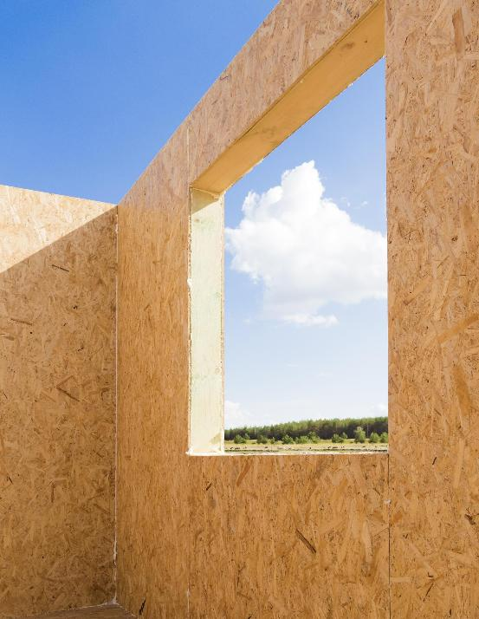
Research task
Activity 1
1. Find a suitable specification for a structural insulated panel (SIPs), including the thickness of:
timber ply outer skin;
breather membrane layer;
insulation;
internal skin of orientated strand board (OSB) with or without a plaster finish (at your discretion).
U-value to meet Building Regulations as stated in: Approved Document L1
2. Find out what the available dimensions are for a modular unit. Make sure you make a note of the references.
Lesson 6, 7 & 8: Modelling a modular house using Autodesk Revit software
Notes:
Building Regulations - https://www.planningportal.co.uk/applications/building-control-applications/building-control/approved-documents/part-l-conservation-of-fuel-and-power/approved-document-l-conservation-of-fuel-and-power-volume-1-dwellings
Image © Shutterstock/SV Production

Slide 5
Client vision and specification
Activity 2
Amira and Claire want to build a two-storey modular house.
They would like a family home for themselves and their two children.
It needs to have two bedrooms, and an open-plan kitchen and dining area.
They also need a family bathroom on the first floor, and a cloakroom/toilet on the ground floor.
The footprint of the house should be no more than 100 m².
Lesson 6, 7 & 8: Modelling a modular house using Autodesk Revit software
Notes:
Image © Shutterstock/JLco Julia Amaral

Slide 6
Designing a house using Autodesk Revit
Activity 2
1. Start by opening a new project in Autodesk® Revit, using an architectural template.
2. Using the dimensions and materials from your research, create a new wall type – start by duplicating the nearest wall type in the properties list.
3. Edit the structure of the wall to specify the materials and thickness of the wall components.
4. Using the wall type you have created, draw a plan of a building module to suitable dimensions from your module research.
5. Next, using an elevation view from the Project Browser, adjust the level to the module height from your research.
6. You can now “copy” your module on plan to create your house shape. (You will need to delete repeated walls.) You can also copy vertically using an elevation view.
7. Check the overall look in 3D View.
Lesson 6, 7 & 8: Modelling a modular house using Autodesk Revit software

Slide 7
Making your modular house a home
Activity 3
1. Add floors, doors, windows, stairs and furnishings.
2. Make sure there is correct access and egress space for stairs.
3. You can use the same wall type to divide rooms in modules.
4. Add bathroom and kitchen fittings via Architecture – Components – Edit family – Plumbing – Fixtures then WC, sink and shower (using Architecture – Components for each new fitting). Outside features can be added from the Site icon, in Site in level menu.
5. Add a roof (draw on Level 1 but change base level to Level 2) – apply an overhang of 200 mm.
6. Label rooms, kitchen fittings, dimension of each room, and overall length and width of the building.
Lesson 6, 7 & 8: Modelling a modular house using Autodesk Revit software

Slide 8
Generating drawings
Activity 4
Using your model of a modular house, generate three drawings:
Rendered 3D front and east elevation of the building
3D floor plan
2D floor plan to scale 1:50
Print in appropriate formats.
Lesson 6, 7 & 8: Modelling a modular house using Autodesk Revit software

Slide 9
Reflection
Activity 4
Have your designs met the client’s vision and specifications?
Explain what each type of drawing shows your clients.
Carry out a peer assessment. Which are your preferred drawings? Explain why.
Think about:
use of materials;
visuals;
annotations;
use of space;
other reasons.
Lesson 6, 7 & 8: Modelling a modular house using Autodesk Revit software

Slide 10
In these lessons, we have:
Consolidation
Plenary
Skills:​
CS1 Produce rendered drawings and illustrations that could be used for marketing a development to the public or similar stakeholders
CS1 Produce rendered drawings and internal plans in response to design briefs and contexts
CS3 Be able to interpret client vision and specification to produce outline design proposals to meet client needs
General competencies:​
English: ​
E3 Create texts for different purposes and audiences​
E5 Synthesise information​
Maths:
M2 Estimate, calculate and spot errors
M3 Work with proportion
M7 Interpret and represent with mathematical diagrams
Digital: ​
D1 Use digital technology and media effectively​
D2 Design, create and edit documents and digital media​
D6 Code and program​
designed a house to fulfil a client’s vision and specification using Autodesk® Revit software;
consolidated and tested knowledge about MMC.
Lesson 6, 7 & 8: Modelling a modular house using Autodesk Revit software

Slide 11
Assessment
Consolidation
Plenary
Complete the end-of-unit assessment individually to assess your understanding of Modern Methods of Construction.
Resources needed
L6, 7 & 8 End-of-unit assessment
Isometric paper
Lesson 6, 7 & 8: Modelling a modular house using Autodesk Revit software

Slide 12
Class questions
Consolidation
Plenary
What new skills have we learned?
Were there any aspects you found especially hard?
Which of these skills are you using on placements?
Are you using other design software for client graphics?
Do you feel you have consolidated the knowledge you have gained so far?
Lesson 6, 7 & 8: Modelling a modular house using Autodesk Revit software

Slide 13
Working with MMC – future skills
Consolidation
Lesson 6, 7 & 8: Modelling a modular house using Autodesk Revit software
Notes:
Skills in Modern Methods of Construction video: https://vimeo.com/1069604418

