Slide 1
Construction
Route: Construction
Topic: Modern Methods of Construction
Lesson 4 & 5: Scheduling on-site and off-site activities for a modular house
Notes:
Image © Shutterstock/Amorn Suriyan

Slide 2
In these lessons, we will:
Introduction
Skills:
CS1 Produce reports and presentations for construction professionals, clients or for non-technical audiences such as the public
CS1 Synthesise information from given case studies, construction projects or site visits
CS3 Applying a logical approach to solving problems
General competencies:
English:
E4 Summarise information/ideas
E5 Synthesise information
Maths:
M10 Optimise work processes
Digital:
D1 Use digital technology and media effectively
D2 Design, create and edit documents and digital media
D6 Code and program
identify the stages of on-site and off-site construction for a volumetric modular house build
produce a schedule for the construction of a modular house.
Lesson 4 & 5: Scheduling on-site and off-site activities for a modular house

Slide 3
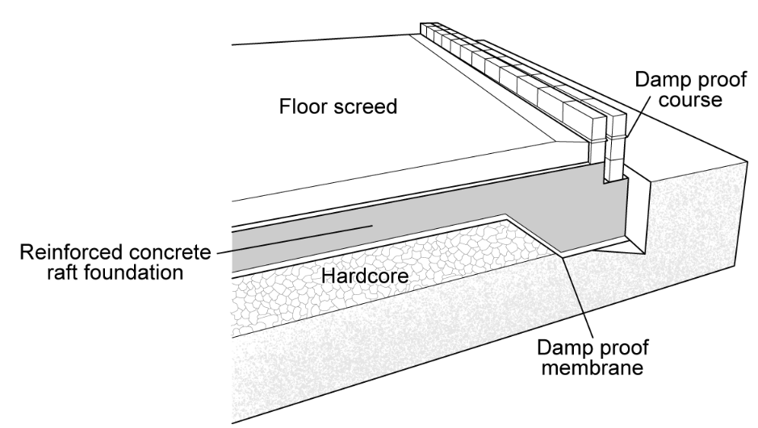
Listing stages for a project
Introduction
Using the image, write a list of the seven activities required to form this reinforced concrete raft foundation.
For example:
Site strip
Excavate foundation depth
Lesson 4 & 5: Scheduling on-site and off-site activities for a modular house

Slide 4
Listing stages for a project
Introduction
Seven activities required to form this reinforced concrete raft foundation:
For example:
Site strip
Excavate foundation depth
Place hardcore
Place foamwork
Place reinforcement
Pour concrete
Vibrate and float concrete, and leave to cure
Lesson 4 & 5: Scheduling on-site and off-site activities for a modular house

Slide 5
Adding stages in Microsoft Project
Introduction
Open a new project in Microsoft Project software.
Add main activities and subtasks under each activity.
Assign timings to each task.*
Set a start date on the first task.
Suggest predecessor.
*Exact timings are not important; if you are unsure how long an activity might take, you can guess.
Lesson 4 & 5: Scheduling on-site and off-site activities for a modular house
Notes:
Microsoft Project is a trademark of the Microsoft group of companies.

Slide 6
Stages of modular construction
Activity 1
See also L4&5 Worksheet (Activity 1)
Lesson 4 & 5: Scheduling on-site and off-site activities for a modular house
Notes:
Stages of a modular build video: https://vimeo.com/1073169748

Slide 7
Check your construction stages
Activity 2
Red processes happen on-site; black processes happen off-site.
Site cleared
Asbestos disposed of by asbestos team
Excavate
Lay drainage
Add water supply
Steel reinforcements placed
Concrete poured
Bolted steel frame platform constructed
Floor joists fixed to platform
First fix plumbing added to floor frame
First fix electrics fixed to floor frame
Floor boarding fixed to floor frame
Floor finishes added
Insulated walls assembled
Insulated walls fixed to floor frame
Windows incorporated into the wall panels
Bathroom fittings
Kitchen fittings
Second fix electrics added
Second fix plumbing added
Roof and ceiling cassettes constructed
Module quality checks
Modules weatherproofed
Modules transported to site
Modules craned into position
Modules connected together
Stairs added
Cladding added
Guttering added
Lesson 4 & 5: Scheduling on-site and off-site activities for a modular house

Slide 8
Example flow chart
Activity 2
First fix plumbing
Bathroom fittings
Second fix electrics added
Bolted steel frame platform constructed
Floor joists fixed to platform
Floor finishes added
Module complete
Floor boarding fixed to floor frame
Second fix plumbing added
First fix electrics
Kitchen fittings
Insulated walls assembled
Windows incorporated into the wall panels
Roof and ceiling frames constructed
Wall panels fixed to floor frame
Modules transported to site
Module quality checks
Lay drainage
Site cleared
Asbestos disposal
Concrete poured
Stairs added
Excavate
Steel reinforcements
Modules craned into position
Modules connected together
Cladding added
Sign-off
Add water supply
Guttering added
Lesson 4 & 5: Scheduling on-site and off-site activities for a modular house

Slide 9
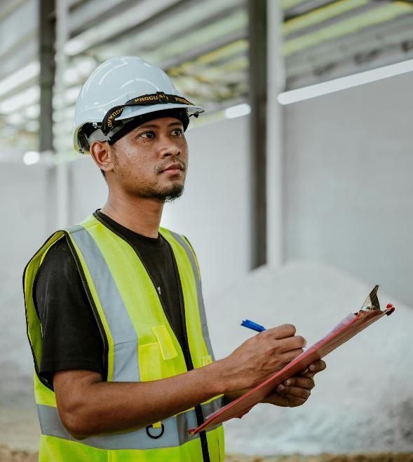
Project management skills are essential
Activity 3
It’s important you understand how work is planned and adjusted to meet the availability of labour and deadlines.
It’s also essential to produce schedules for site management. While works proceed, you might need to understand project planning for the purposes of:
tender;
tracking materials;
anticipating labour requirements.
Lesson 4 & 5: Scheduling on-site and off-site activities for a modular house
Notes:
Image © Pexels/Ihsan Adityawarman

Slide 10
Scheduling modular building stages
Activity 3
Open a new project in the chosen project software.
Add main activities and subtasks under each activity.
Assign timings to each task.
Set a start date on the first task.
Suggest predecessors.
Assign resources to each task.
Lesson 4 & 5: Scheduling on-site and off-site activities for a modular house

Slide 11
Use of data
Activity 4
In Microsoft Project, view your data in the following formats:
network analysis
resource sheets
calendars
Gantt chart
Discuss in pairs what these different formats might be used for.
Lesson 4 & 5: Scheduling on-site and off-site activities for a modular house

Slide 12
In these lessons, we have:
Plenary
Skills:
CS1 Produce reports and presentations for construction professionals, clients or for non-technical audiences such as the public
CS1 Synthesise information from given case studies, construction projects or site visits
CS3 Applying a logical approach to solving problems
General competencies:
English:
E4 Summarise information/ideas
E5 Synthesise information
Maths:
M10 Optimise work processes
Digital:
D1 Use digital technology and media effectively
D2 Design, create and edit documents and digital media
D6 Code and program
identified the stages of on-site and off-site construction for a volumetric modular house build
produced a schedule for the construction of a prefabricated modular house.
Lesson 4 & 5: Scheduling on-site and off-site activities for a modular house

